Slide 1

Dimension Reduction Methods

Slide 2
MKT 591: Course Roadmap
Review of Quant Market Research
Prediction / Regression
Forecasting
Features & Dimensions
Market Segmentation
Simple Linear Regression
Demand Forecasting
Customer Classification
Factor Analysis
Segmentation Basic
Measurement Scales
Categorical Variables
BASS Diffusion Model
Discriminant Analysis
MDS
Advanced Model-based Segmentation
Discrete Analysis (CrossTab)
Extracting Features by Text Analytics
Multiple Regression
Bayesian Classifier
Spatial Segmentation
Continuous Analysis (Correlation)
Issues in Regression
Tree Models
Deep Learning
Logistic Regression (Consumer Choice)
Bayesian Statistics

Slide 3
Class Outline
Dimension Reduction Methods
Factor Analysis
Principal Component Analysis (Not today)
Dimension Reduction Practice using R
Dupont Marketing Application Case
Notes:
X1 and x2 are similar with correlation, they have the same prediction power, therefore drop one
Dimensionality reduction

Slide 4
Dimension (Data) Reduction
Simplifies data by mapping multi-dimensions of the inputs into a lower-dimensional space

Slide 5
A simple starting question
A group of 12 students rated the importance of “faculty reputation” and “program reputation” in their choice of B-school.
r=0.911
1or 2 variables?

Slide 6
A Simple Question
Are these two dimensions or are the two variables measuring a same thing?
Heuristically: Technically not exactly same thing, but almost similar one about reputation.
Can the number of variables be combined (reduced) from 2 to 1?
One possible opinion: Well… possibly! given r is very high.

Slide 7

Example : Bank Survey Case
A study was conducted by a bank to determine whether or not special marketing programs should be developed for several key segments.
One of the study’s research questions concerned attitudes toward banking.
The respondents were asked to express their opinions (attitudes) on a 0-9, agree-disagree scale (interval scale) on five items.

Slide 8
Bank Survey Example: Five questions about attitudes
Small banks charge less than large banks (X1).
Large banks are more likely to make mistakes than small banks (X2).
Tellers do not need to be extremely courteous and friendly, it is enough for them simply to be civil (X3).
I want to be known personally at my bank and be treated with special courtesy (X4).
If a financial institution treated me in a impersonal or uncaring way, I would never patronize that organization again (X5).

Slide 9
Data from 15 respondents (Example 2)
Obs | X1 | X2 | X3 | X4 | X5
1 | 9 | 6 | 9 | 2 | 2
2 | 4 | 6 | 2 | 6 | 7
3 | 0 | 0 | 5 | 0 | 0
4 | 2 | 2 | 0 | 9 | 9
5 | 6 | 9 | 8 | 3 | 3
6 | 3 | 8 | 5 | 4 | 7
7 | 4 | 5 | 6 | 3 | 6
8 | 8 | 6 | 8 | 2 | 2
9 | 4 | 4 | 0 | 8 | 8
10 | 2 | 8 | 4 | 5 | 7
11 | 1 | 2 | 6 | 0 | 0
12 | 6 | 9 | 7 | 3 | 5
13 | 6 | 7 | 1 | 7 | 8
14 | 2 | 1 | 7 | 1 | 1
15 | 9 | 7 | 9 | 2 | 1

Slide 10
Let’s see Correlation Matrix
Proximity matrix (Pearson correlation coefficient):
 | X1 | X2 | X3 | X4 | X5
X1 | 1 | 0.610 | 0.469 | -0.018 | -0.096
X2 | 0.610 | 1 | 0.230 | 0.190 | 0.319
X3 | 0.469 | 0.230 | 1 | -0.832 | -0.774
X4 | -0.018 | 0.190 | -0.832 | 1 | 0.927
X5 | -0.096 | 0.319 | -0.774 | 0.927 | 1
One factor can be made up of X1 and X2.
Another factor can be made up of X3, X4, and X5.
Underlying Data Structure: Out of 5 question items, X1 and X2 are highly correlated and X3, X4 and X5 are highly correlated.
Notes:
FA is looking for “blocks of items” where there is high correlation within blocks, low correlation across blocks.

Slide 11
Graphical Model
There are J=5 original items.
We would simplify them by K=2 general factors.
(Simply) Factor analysis : (1) which items are linked to which factors, (2) how many factors we need, and (3) an ability to name these factors.
Factor 1
Factor 2
factor loadings
X 1
X 2
X 3
X 4
X 5

Slide 12
Factor Analysis
General Idea:
You have a set of measured variables (items), X₁,…,X_{J.}
X₁,…,X_{J} may actually be indicators of “higher-level” dimensions (or underlying beliefs/constructs).
Analysts want to summarize:
How many factors are there in our J items.
What these dimensions (factors) means (labeling).
How each of the items maps on to these factors.

Slide 13
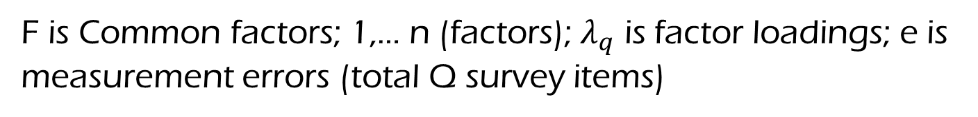

Factor Model
Ideal: $X_{1}=F_{1}+e_{1}$
$X_{2}=F_{1}+e_{2}$
$⋮$
$X_{Q}=F_{n}+e_{Q}$
Reality: $X_{1}=λ_{1}F+e_{1}$
$X_{2}=λ_{2}F+e_{2}$
$⋮$
$X_{Q}=λ_{Q}F+e_{Q}$
Exact matching between items and factors
Linear combination of factors per each item (see slide 18 for this)
F is Common factors; 1,… n (factors); $λ_{q}$ is factor loadings; e is measurement errors (total Q survey items)
Garrett-Mayer, Johns Hopkins University, 2006

Slide 14

Factor Analysis
Matrix of Factor Loadings
$$X=λF+e$$
Measurement error
Observed Variables
Common Factors (Unobservables)
Factor Analysis can be used for data reduction (i.e., reduce the number of variables needed for analysis) – concise representation of the data.
Factor analysis is able to summarize the information contained in a larger number of variables into a smaller number of ‘factors’ (without significant loss of information -- desirably).

Slide 15

“Why” Factor Analysis
Data reduction is important when you need to measure “fuzzy” concepts (which are commonly measured in Marketing) such as ‘service quality’, ‘consumer trust’ or ‘customer loyalty’
Usually ask multiple questions that tap into the various dimensions of the abstract concepts.
Too many variables! Factor analysis can help to reduce this dimensionality problem – E.g., What if 100 variables in modern big, complicated data?

Slide 16
Intuition of Factor Analysis
Factor analysis assumes that the correlation between a large number of variables is due to them all being dependent on the same small number of “factors”.
Analyze the patterns of correlations to tap into the underlying dimension (construct) for managerial purpose.
Example: Car Ratings
Perception of seats
Perception of noise
Perception of
“quality”
Perception of smoothness of ride
(Factor)
Perception of AC-system
(Attributes/Features)

Slide 17
Factor Analysis
Key point
When we make up these higher-level dimensions/factors (K), we want to retain as much “information” as possible in the original Q items.
Q items → K ≤ Q higher-level factors
At the same time, we want to simplify the data, If K>Q, there is no point to conduct factor analysis…

Slide 18
So, what is a construct (factor or dimension)?
Construct 1
Construct 2
Construct K
Not so ideal but this happens in real data
…
Item 1
Item 2
Item 3
Item 4
Item Q
A construct is comprised of a subset of items that are measuring the relevant higher latent factor/dimensions.

Slide 19
Methodological Benefits
Simplicity: Reduce redundancies in survey items
-- Multiple survey items whose responses are so highly correlated that they are essentially redundant.
Collinearity issue: Create uncorrelated (orthogonal) measures useful for clustering, regression and other methods.
-- Multicollinearity is no longer a problem (one of solutions for collinearity problem between independent variables)
Overall, get “clean” estimates of the effect of each construct on the dependent measure of interest.

Slide 20
Outputs from Factor Analysis
Factor loadings: Weights that determine how each factor affects each attribute. The loadings help you to determine the name (i.e., labeling) that best describes the factor.
Factor scores: These are the respondents’ inferred ratings on the underlying basic dimension (e.g., a ‘quality’ rating) – can be used for regression analysis.
e.g.,
Notes:
Ideally, factor scores would therefore represent the score of each person on the underlying latent variable (based on your description, I assumed you had various people rate the importance of these 30 attributes).
Factor Loadings: Definitely different from regression coefficients but we can understand similar way. Weights of linear combinations of factors to items.
A factor score is a numerical value that indicates a person's relative spacing or standing on a latent factor.

Slide 21
Factor Analysis Procedure - Step 0: Identify your problem
STEP 0:
Think about “why do we need factor analysis?”
Factor analysis can help to solve marketing analytics problem? (Understanding simplified dimensions/factors of the market)
Check the number of variables & their interpretability and correlations structure between multiple independent variables (exploratory analysis).

Slide 22
Factor Analysis Step 1: How many factors?
STEP 1: Determine the number of factors K
Criterion 1 (Eigenvalues):
Keep all factors with eigenvalues > 1 (commonly used).
Criterion 2 (A Scree Plot – graphically):
Plot on Y-axis the % variance explained or the eigenvalues and on the x-axis the number of factors.
Look for a “kink” in the plot.
Criterion 3 (% of explained variance):
Accept a factor analysis solution where % variance explained > Z%. (e.g. Z=50 or above).
Let’s see how to do this in R!
Notes:
2 factors can explain 90 % 3rd 5%; 4th 3%; 5th 2%

Slide 23
Factor Analysis Step 1: How many factors?
Two factors with eigenvalue > 1.
The first two factors account for 90% of the variance contained in the 5 variables.
 | F1 | F2 | F3 | F4 | F5
Eigenvalue | 2.755 | 1.775 | 0.377 | 0.065 | 0.028
Variability (%) | 55.092 | 35.497 | 7.542 | 1.299 | 0.569
Cumulative % | 55.092 | 90.589 | 98.131 | 99.431 | 100.000

Slide 24
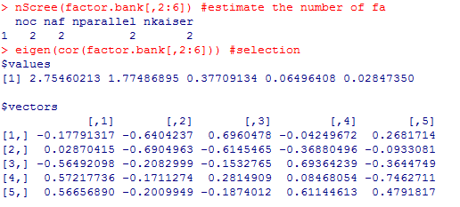
In R, (nFactors package) for selecting number of factors
Optical coordinates (oc); Acceleration factors (af); Parallel analysis; Kaiser rule.
You don’t have to know but if you really want, please see nFactors package manual
Eigenvalues > 1 ?

Slide 25
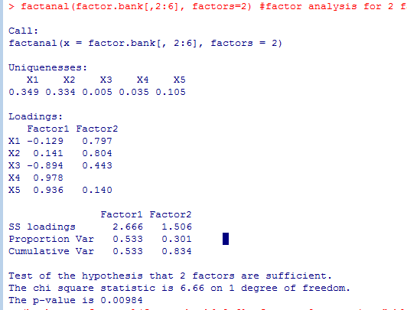
In R (Orthogonal factors)
Interpretation?
Don’t use this testing… (not commonly used.) ← cf., it is testing for null hypothesis that 2 factors are having perfect fit

Slide 26
Factor Analysis Step 2: Factor Rotation
To enhance the interpretability of the factors (Not Required but commonly used).
Varimax procedure: an orthogonal method of rotation that minimizes the number of variables with high loadings-- Orthogonal rotation results in factors that are uncorrelated (default in R ‘factanal’ function).
Oblique rotation : the axes are not maintained at right angles, and the factors are correlated. Sometimes, allowing for correlations among factors can simplify the factor pattern matrix.
Notes:
For oblique rations, F1 and F2 (or D1 and D2) axes are not right angle… if you don’t want, you can type “none” for rotation.

Slide 27
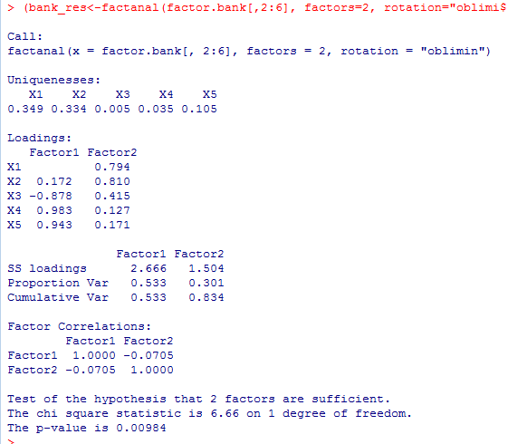
In R (with Oblique rotation)
Factors are not orthogonal anymore

Slide 28
Factor Analysis Step 2: Factor Rotation
Factor loadings after Varimax rotation:
 | D1 | D2
X1 | -0.175 | 0.886
X2 | 0.173 | 0.905
X3 | -0.891 | 0.404
X4 | 0.972 | 0.096
X5 | 0.968 | 0.136
Factor loadings:
 | F1 | F2
X1 | -0.295 | 0.853
X2 | 0.048 | 0.920
X3 | -0.938 | 0.278
X4 | 0.950 | 0.228
X5 | 0.940 | 0.268
Loading values are changed…
Notes:
https://www.ibm.com/support/knowledgecenter/SSLVMB_22.0.0/com.ibm.spss.statistics.algorithms/alg_factor_promax.htm
To find better fit… using mathematical matrix computation

Slide 29
Factor Analysis Step 3: Assign attributes to factors
STEP 3: Assign original attributes (X) to factors (F)
Look at factor loading matrix L.
Determine a critical value L* (e.g. 0.7, 0.6, etc. – Analysts can decide this threshold).
Say all X’s with |L| ≥ L* load on factor F
(e.g., |-0.75|>0.7*, if the analyst choose 0.7 as L*)

Slide 30
Factor Analysis Step 4: Naming (Label) the Factors – Bank Survey Example
Small banks charge less than large banks (X1).
Large banks are more likely to make mistakes than small banks (X2).
Tellers do not need to be extremely courteous and friendly, it’s enough for them simply to be civil (X3).
I want to be known personally at my bank and be treated with special courtesy (X4).
If a financial institution treated me in a impersonal or uncaring way, I would never patronize that organization again (X5).
Factor 2: Objective Performance
Factor 1: Subjective Service/Care

Slide 31
Factor Analysis Step 5: Factor Scores
Look at factor scores for each individual on each factor
Once you run a factor analysis, if it adequately fits, you might no longer “use” the original Xs (X_{i1},…X_{i5}) in subsequent analyses, but you use F_{i1},…F_{iK} (Factor scores).
Uncorrelated measure, general constructs (dimensions) to have managerial actions and interpretations after naming.
These are our (new) Xs from this point onwards.
Notes:
Factor scores are essentially a weighted sum of the items. I find it helpful to think of factor scores as standardized weighted averages.
A factor score is a numerical value that indicates a person's relative spacing or standing on a latent factor.

Slide 32
Factor Analysis Step 6: Managerial implications – Bank Survey Example
There are two general factors.
First factor:
Service/Care - Q3, Q4, Q5
Second factor:
Objective performance (e.g., Price/value) - Q1, Q2
The factor scores could now be used in future analyses.

Slide 33
In-Class practice (5 minutes)
Please run linear regression with Y (AcctVolume) and 5 X items. Any potential problems can you find?
Please run factor analysis and use factor scores for linear regression with Y (AcctVolume) and the factor scores (use the default ‘varimax’ rotation with ‘Bartlett’ method for factor scores). What can you find compared with the previous regression results?

Slide 34
Summary for Factor Analysis
Provides managers with higher-level underlying factors that are more managerially actionable and describable.
Reduces the number of items from Q items to K≤Q factors (Simplicity)
Factors are uncorrelated which provides clean interpretation when using the results in future analyses.
Provides managerial understanding as to the key issues
Limitations:
There are decision rules but interpretation might be subjective for some cases…
It is difficult to apply discrete variables (e.g., nominal ones)

Slide 35
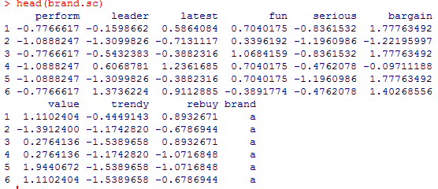
In-class Practice with R
Brand Ratings Data (see p195 to p200 in our textbook)
Consumer ratings of brand with regard to perceptual adjectives as expressed on survey items with scale 1 to 10 (interval scale)
In this data, an observation is one respondent’s rating of a brand on one of the adjectives: e.g., how trendy is intelligent coffee?
The Data here comprise simulated ratings of 10 brands (“a” to “j”) on 9 adjectives (e.g., “performance”, “leader”, “latest”, “fun”, etc.)

Slide 36
[In-class Practice] Questions with Brand Ratings Data (5 minutes)
How many factors (Try Eigenvalue 1 or 2 as a criteria)?
What factors (naming) can we find?
How can we characterize those factors?

Slide 37
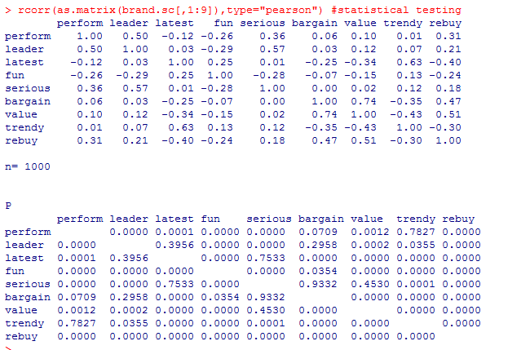
Correlation Matrix
Partially, somewhat significant correlations between variables…

Slide 38
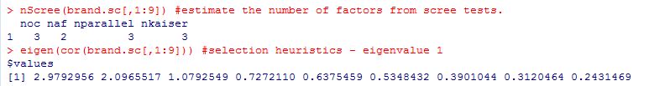
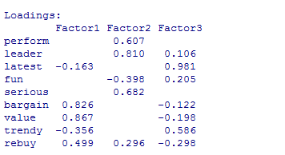
How many factors?
I would choose 3 factors…
Factor Loadings
Factor 1: Value for money
Factor 2: Leader
Factor 3: Latest/trendy

Slide 39
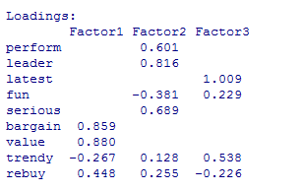

Factor Loadings (Oblique rotation)
I would choose 3 factors…
Bit different but overall pattern is similar to default factor analysis
Correlation matrix showing the relationships between the estimated latent factors.

Slide 40
Graphical representation

Slide 41
Managerial implications
Compute mean values (use the provided function [see the hardcopy of R code] to compute mean values across brands.) Which brand(s) show strong “value for money”? Which brand(s) show weak “value for money”?
Which brands are positioned as leading brands?
Which brand are positioned as trendy ones?

Slide 42
Dupont Application Case Example

Slide 43
DuPont mail survey
Total 58 respondents.
One set of questions involved satisfaction with DuPont in 6 primary areas.
An additional set of questions were about interests of the company, their size, number of employees, etc…
Demographic/Background questions
Exp1 = interest in exporting.
Size = Number of employees in thousands.
Revenue = Amount sold to that company by DuPont in $MM.
Years = Number of years as a DuPont customer.
Numprod = Number of products that they buy from DuPont.

Slide 44
Dupont Data
Survey Questions
Q1-Q4 = questions about quality
TS1-TS3 = questions about tech support
SM1-SM2 = questions about sales and marketing support
SD1-SD7 = questions about supply and delivery
INN1-INN3 = questions about innovation
Overall = overall satisfaction

Slide 45
Sample Question
Please rate DuPont on a 1-10 scale on each of the following questions:
Ratings questions, treated as continuous, grouped into a priori blocks, randomization across blocks and within blocks.
 | PRODUCT QUALITY | Rating
01 | THE RANGE OF CHOICES IN THE (product) PRODUCT LINE | _______
02 | THE CONSISTENCY OF (product) QUALITY FROM LOT TO LOT | _______
03 | THE WAY (product) PROCESSES IN YOUR MANUFACTURING OPERATIONS | _______
04 | THE WAY (product) PERFORMS IN YOUR FINISHED PRODUCTS | _______

Slide 46
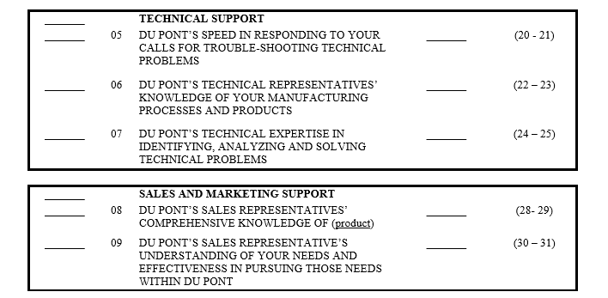
Questions

Slide 47
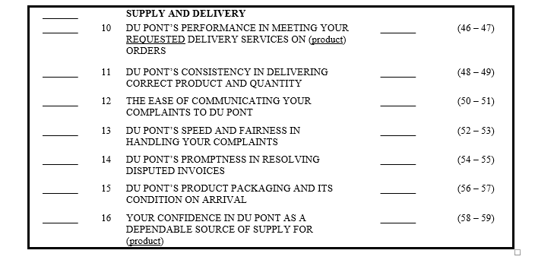
Questions

Slide 48
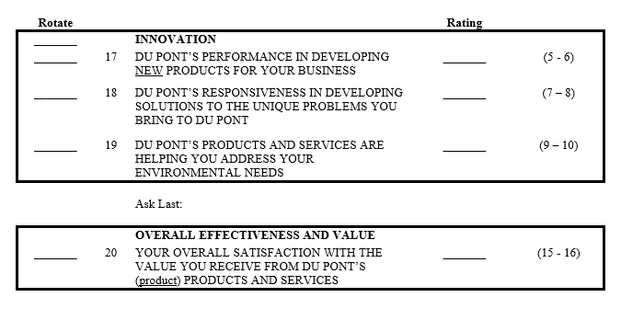
Questions

Slide 49
Analysis Goals
What do demographics tell us?
Run a factor analysis and explore the number of factors.
Understand the heterogeneity of factors across segments.
Understand the drivers of revenue in the different segments.

Slide 50
Step 1:
Correlation Matrix of Demographics
Numprod correlated with Size.
Proximity matrix (Pearson correlation coefficient):
 | Size | Revenue | Years | Numprod
Size | 1 | -0.119 | -0.211 | 0.569
Revenue | -0.119 | 1 | 0.238 | -0.071
Years | -0.211 | 0.238 | 1 | -0.166
Numprod | 0.569 | -0.071 | -0.166 | 1

Slide 51
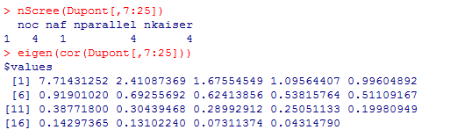
Step 2: Run Factor Analysis
Use 19 survey questions : Q1 – INN3
How many factors? Let’s use Four Factors…

Slide 52

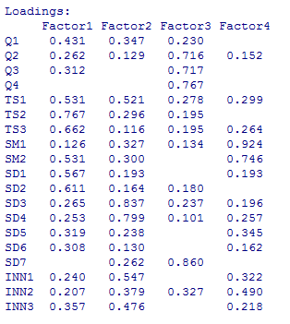
Factor Analysis (Orthogonal)
Factor Loadings
59.2 % of variance explained
How to Interpret Factors?
Factor Names
Factor 1: Tech Support
Factor 2: Supply
Factor 3: Quality
Factor 4: Marketing

Slide 53
Step 3:
Let’s utilize factor scores for segmentation analysis
Cluster Analysis with the factor scores.
Run k-means method (E.g. k =2) for clustering in this example. In addition, I will try Gaussian Mixture method as well.
Link between Cluster Analysis and Factor Analysis results.
We will cover cluster analysis later…

Slide 54
Step 3:
2 Clusters
Class | Tech | Supply | Quality | Marketing | N of Cluster | Within-class variance
1 | -1.570 | -0.053 | -0.286 | -0.567 | 12.000 | 6.846
2 | 0.410 | 0.014 | 0.075 | 0.148 | 46.000 | 2.517
Core Segment likes us.
2nd group is not too happy – positive but relatively low scores in supply and quality.
Segment Sizes OK.

Slide 55
Step 3:
Segment 1 does not like us but buys from us because of Supply.
3 Clusters
Class | Tech | Supply | Quality | Marketing | N of Cluster | Within-class variance
1 | -1.128 | 0.326 | -0.848 | -1.769 | 7.000 | 6.520
2 | 0.181 | 0.612 | 0.413 | 0.177 | 29.000 | 1.509
3 | 0.120 | -0.910 | -0.274 | 0.330 | 22.000 | 3.514
Segment 2 loves us.
Segment 3 like our product Marketing.

Slide 56
Step 3:
Segment 1 does not like us.
4 Clusters
Class | Tech | Supply | Quality | Marketing | N of Cluster | Within-class variance
1 | -0.126 | -0.543 | -0.653 | -1.847 | 7.000 | 7.506
2 | 0.601 | 0.020 | -0.382 | 0.243 | 27.000 | 1.274
3 | -2.401 | -0.062 | 0.549 | -0.009 | 6.000 | 6.528
4 | -0.052 | 0.202 | 0.644 | 0.356 | 18.000 | 1.761
Segment 2 likes our Tech Support.
Segment 3 like our Quality.
Segment 4 like our Sales and Marketing.

Slide 57
Step 3:
5 Clusters
Class | Performance | Quality | Supply | Support | N of Cluster | Within-class variance
1 | 0.225 | -1.695 | 0.887 | -1.244 | 4.000 | 5.444
2 | 0.378 | -0.077 | -0.522 | 0.282 | 28.000 | 1.434
3 | -2.401 | -0.062 | 0.549 | -0.009 | 6.000 | 6.528
4 | 0.213 | 0.565 | 0.817 | 0.268 | 17.000 | 0.875
5 | -0.235 | -0.098 | -2.036 | -2.480 | 3.000 | 4.499
We may have gone too far! Don’t go further after K=4.

Slide 58
Step 4:
Description of each Cluster (Using Demographics data)
The companies that do not like us tend to be the big ones who buy a lot of different products and spend a lot of money!
Selecting number of segments (K) based on interpretability for K-means. But, we can select the K statistically fit (BIC(with Gaussian Mixture.
 | Values
Row Labels | Average of Size | Average of Revenue | Average of Years | Average of Numprod
1 | 51.14 | 2.26 | 6.19 | 7.29
2 | 41.33 | 1.36 | 6.28 | 4.52
3 | 47.17 | 1.45 | 6.42 | 5.00
4 | 39.39 | 1.58 | 6.28 | 4.28
Grand Total | 42.52 | 1.55 | 6.28 | 4.83

Slide 59
Punch Line
Factor analysis is a widely used technique to uncover higher order structure (i.e., underlying dimensions).
It leads to managerially interesting variables and actions.
Widely used technique to confirm an underlying structure, i.e. useful for checking questionnaire design.
Domain-specific knowledge (theory) can be applied to select or interpret final model.

Slide 60
MKT 591: Course Roadmap
Review of Quant Market Research
Prediction / Regression
Forecasting
Features & Dimensions
Market Segmentation
Simple Linear Regression
Demand Forecasting
Customer Classification
Factor Analysis
Segmentation Basic
Measurement Scales
Categorical Variables
BASS Diffusion Model
Discriminant Analysis
MDS
Advanced Model-based Segmentation
Discrete Analysis (CrossTab)
Extracting Features by Text Analytics
Multiple Regression
Bayesian Classifier
Spatial Segmentation
Continuous Analysis (Correlation)
Issues in Regression
Tree Models
Deep Learning
Logistic Regression (Consumer Choice)
Bayesian Statistics

